Slide 1
4 Major Micronutrient Deficiencies
Iron
Iodine
Vitamin A
Zinc
→ Anemia
→ Iodine Deficiency Disorders (IDD)
→ Xeropthalmia
→ Multiple disorders

Slide 2

Anemia
Most common global nutrition problem
Common causes of anemia
  Iron deficiency anemia (IDA)
  Infections (malaria, hookworm, HIV)
  Other vitamin deficiencies
  Hemoglobinopathies
Health impact
  Perinatal & maternal mortality
  Delayed child development
  Reduced work capacity
Notes:
Iron deficiency is the most common cause of anemia and most common preventable nutritional deficiency.

Slide 3
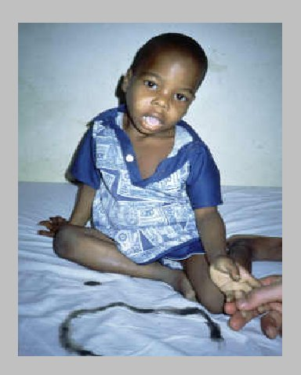
Anemia- Risk Factors
Low dietary intakes
  Diet poor in iron-rich foods/animal foods
  High intake of inhibitors (Tea)
Infections (malaria, helminthes infection, schistosomiasis)
Blood loss

Slide 4
Anemia- Signs & Symptoms
Tiredness and fatigue
Headache and breathlessness
Pallor: pale conjunctivae, palms, tongue, lips and skin

Slide 5
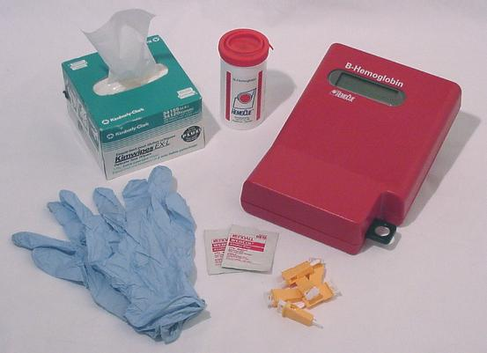
Anemia- Assessment
Blood can be tested for anaemia using different methods which look at the colour of the blood, the number of blood cells, or use a chemical which reacts with the haemoglobin.
  Hemoglogin (Hemocue)
  Hematocrit
Defined by WHO as:
  Hb <11.0 g/dL – children
  Hb <12.0 g/dL – women
  Hb <12.0 g/dL - Men
Notes:
WHO recommends blanket supplementation to all children 6-24mo where anemia prevalence >20-30%
Require 0.8mg of bioavailable iron/day

Slide 6
Indicators of Iron Status
Soluble transferrin receptor (sTfR)
Ferritin (FER)
Iron (Fe) and total iron binding capacity (TIBC)
Zinc protoporphyrin (ZP)
Hemoglobin (Hb)
Lab
Price, Complexity of Test
Field

Slide 7
Anemia- Treatment
Dietary diversification
  Foods that are rich in iron include:
    Meat
    Fortified cereals
    Spinach
    Cashew nuts
    Lentils and beans
Fortification
Iron supplements
Notes:
WHO recommends blanket supplementation to all children 6-24mo where anemia prevalence >20-30%
Require 0.8mg of bioavailable iron/day (BM only provides 0.4mg).

Slide 8
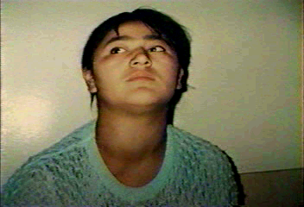
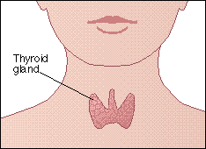
Iodine Deficiency Disorders (IDD)
Significant cause of preventable brain damage in children
Health effects:
  Increased perinatal mortality
  Mental retardation
  Growth retardation
Preventable by consumption of adequately iodized salt

Slide 9

Iodine Deficiency Affects the Brain
Cretinism
Goiter
Reduced intellectual
performance
*Goiter manifests only a small portion of IDD
Notes:
Even mild IDD can reduce IQ by 13.5 points!

Slide 10
IDD- Risk Factors
Low iodine level in food
  products grown on iodine-poor soil
      erosion, floods
      mountainous areas
  distance from sea (low fish intake)
Non-availability of iodized food (salt)

Slide 11
IDD- Assessment
Measure urinary iodine excretion (UIE)
Measure levels of thyroid hormones in blood
Measure degree of goitre
  Grade 0 No Goitre
  Grade 1 Palpable Goitre
  Grade 2 Visible Goitre

Slide 12

Salt Iodine Measurement
Titration
Gold standard
Lab
WYD Iodine Checker
Single wavelength (585 nm) spectrophotometer
Measures iodine level (ppm) in salt based on the
absorption of the iodine-starch blue compound
Price, Complexity of Test
Rapid Kit
Qualitatively measures iodine content in salt
Highly sensitive but not specific
Inexpensive
Field
Notes:
Various methods are available for testing the iodine content of salt. The “goal standard” for detecting iodine content in salt is the titration method. However, titration requires skilled laboratory personnel and is time-consuming and costly, so it is not recommended for routine monitoring purposes. Prior studies have shown that rapid salt kits are suitable and appropriate to accurately distinguish between iodized and non-iodized salt. Rapid kits are field-friendly, inexpensive, and sensitive, so UNICEF recommends them for qualitative assessment of salt iodization in household surveys or spot checks of food quality. The WYD Iodine Checker, which uses a single wavelength spectrophotomometer to measure the iodine level in salt based on the absorption of the iodine-starch blue compound, has been shown to be highly precise, accurate, and sensitive when compared to the titration method.

Slide 13
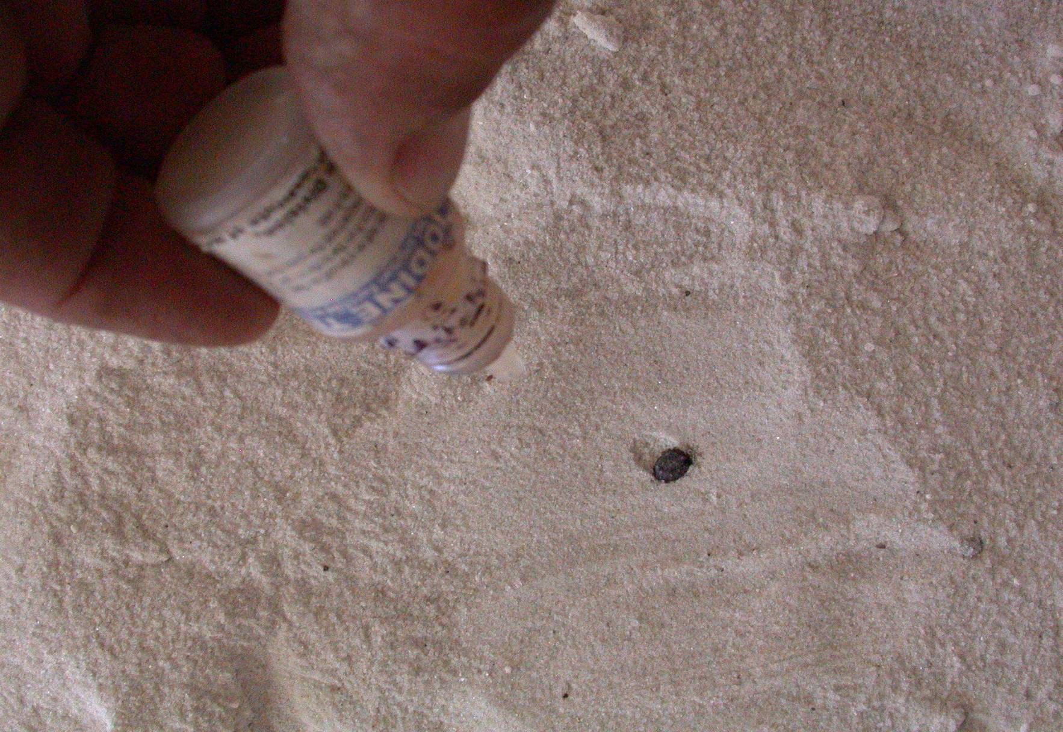
Notes:
This picture shows a field worker testing salt for the presence of iodine using the MBA rapid salt test kit

Slide 14
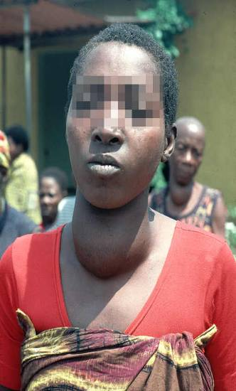
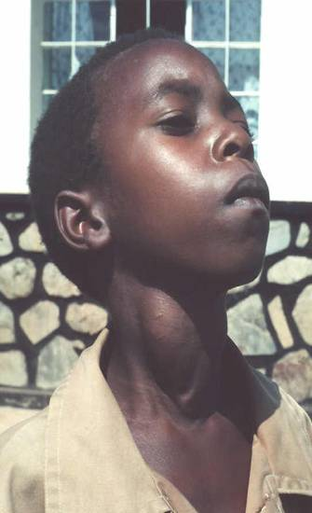
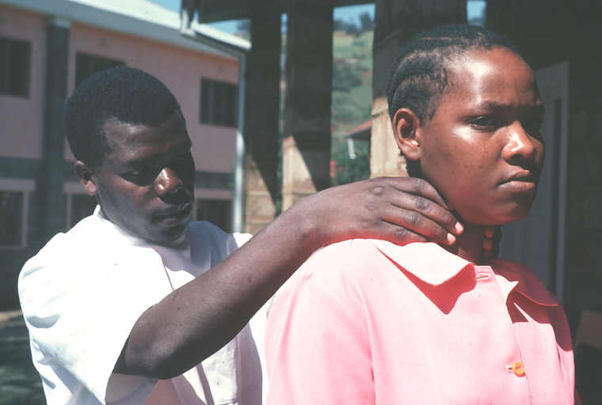
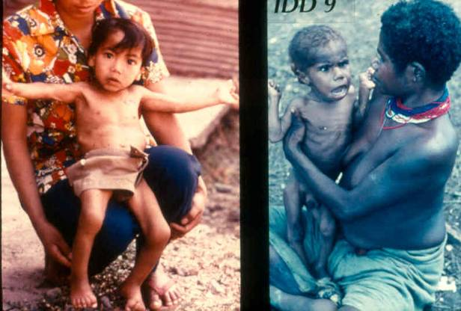
Goiter examination
Cretinism
Notes:
Examination for goiter

Slide 15
Zinc Deficiency
Zinc essential for the function of many enzymes and metabolic processes
Zinc deficiency is common in developing countries with high mortality
Zinc commonly the most deficient nutrient in complementary food mixtures fed to infants during weaning
Zinc interventions are among those proposed to help reduce child deaths globally by 63% (Lancet, 2003)

Slide 16
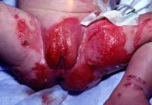
Zinc Deficiency- Signs & Symptoms
Hair loss
Skin lesions
Diarrhea
Poor growth
Acrodermatitis enteropathica
Death
Notes:
WHO 2005: “Vitamin A deficiency (VAD) is a public health problem in more than 118 countries and affects more than 140-250 million preschool children worldwide.”

Slide 17
Zinc Deficiency- Assessment
No simple, quantitative biochemical test of zinc status
Serum Zinc
  Can fluctuate as much as 20% in 24-hour period
  Levels decreased during acute infections
  Expensive
Hair zinc analysis

Slide 18
Zinc Deficiency- Treatment
Regular zinc supplements can greatly reduce common infant morbidities in developing countries
  Adjunct treatment of diarrhea
    → 20mg /day x 10 days
  Pneumonia
  Stunting
Zinc deficiency commonly coexists with other micronutrient deficiencies including iron, making single supplements inappropriate
Dietary diversification
  Animal protein (oysters, red meat)
Notes:
WHO 2005: “Vitamin A deficiency (VAD) is a public health problem in more than 118 countries and affects more than 140-250 million preschool children worldwide.”

Slide 19
Summary
Major risk factors for micronutrient deficiency diseases include poor dietary intake, infection, disease and sanitation
The 4 major MDD are anemia, iodine deficiency, vitamin A deficiency, and zinc deficiency
Treatment for MDD include dietary diversification, supplementation, and food fortification

Slide 20
Specific Nutritional Deficiencies
Iodine Deficiency
Iron Deficiency
Vitamin A
Vitamin D

Slide 21
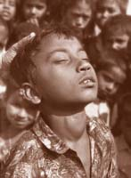
Iodine deficiency - thyroid
“Simple goiter is the easiest of all known diseases to prevent . . .
It may be excluded from the list of human diseases as soon as
society determines to make the effort” David Marine 1923

Slide 22
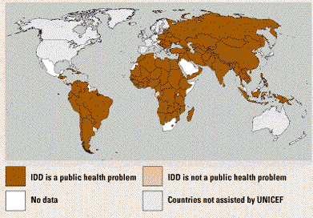
Iodine Deficiency Disorders
Source: State of the World’s Children, 1998

Slide 23
Causes of Iodine Deficiency
Mountainous areas at risk (soils leached by high rainfall, melting snow, flooding)
Culturally induced behavioral change
  Tasmanian Aboriginals migrated every season until European invasion, became sedentary and had incidence of thyroid problems

Slide 24
Iodine Deficiency: Severe
Goiter: most commonly recognized consequence (enlarged thyroid)
  Occurs when thyroid gland is unable to meet the metabolic demands of the body through sufficient hormone production – thyroid compensates by enlarging (works in short term)
Cretenism: proximal pyramidal signs, intellectual impairment, primitive reflexes
  Only occurs with severe fetal iodine deficiency

Slide 25
Iodine Deficiency: Moderate
Studies comparing 2 Villages
  Consistent results: meta-analysis showed 13.5 IQ point difference between groups
Intervention Studies
  Prenatal supplementation (esp. 1st trimester): clear impact – prevents cretenism, and affects mental development in children
  Childhood supplementation: many mediocre studies, but positive impact

Slide 26
Iron deficiency - anemia
%
Source: UN-ACC-SCN-IFPRI-4 Report on World Nutrition Situation

Slide 27
Iron Deficiency
Iron is critical for body:
  Carries oxygen to tissues from lungs
  Transports electrons within cells
  Integral part of important enzyme reactions
Anemia is caused most commonly by iron deficiency (anemia is found in 40-60% of women and children in developing countries)

Slide 28
Iron Deficiency Consequences
Iron deficiency results in:
  Decreased work capacity and work productivity
  Permanently impaired development
    Psychomotor development of anemic children will be reduced by 5-10 IQ points
  Increased morbidity and mortality from infections
  Decreased growth

Slide 29
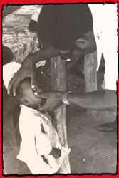
Vitamin A Deficiency
Vitamin A is important because it is essential to vision, fetal development, immune response
250 million children of pre-school age lack sufficient Vitamin A in their diet.
350,000 become blind each year, and half of them die within a year of becoming blind….
Notes:
Effect: 250 million children of pre-school age around the world lack sufficient vitamin A in their diet... of these, 2 million die each year and 350,000 become blind.
According to the World Health Organization (WHO), 80% of the blindness today is preventable or treatable. Vitamin A deficiency is the leading cause of blindness in children.
The prevalence of blindness in many parts of the world today is high enough to be classified a public health problem, thus alerting responsive governments of the need to invest in eye health interventions

Slide 30
Vitamin A Deficiency
Associated with blindness and increased severity of infections such as measles and diarrhoeal disease
WHO estimates that 2.8 million children under 5 years old have signs of clinical xerophthalmia (childhood blindness)
WHO estimates that 14 million pre-school children already have some eye damage from Vitamin A deficiency
Notes:
Vitamin A deficiency is associated with blindness and increased severity of infections such as measles and diarrhoeal disease. The 1995 estimates from the WHO Micronutrient Deficiency Information System database indicate that approximately 2.8 million children under five years old currently exhibit signs of clinical xerophthalmia, and 14 million pre-school children already have some eye damage from vitamin A deficiency. Blindness would almost certainly have a detrimental effect on children’s development and behaviour, especially where facilities for blind children are lacking.

Slide 31
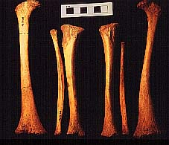
Vitamin D Deficiency: Rickets
http://www.spoilheap.co.uk/rickets.htm
Notes:
The left femur has extensive lateral bowing in its distal two-thirds with wide splaying of its distal end. The right femur is deformed in the same way, but less so. The left tibia and fibula are also much deformed, being bowed laterally from just below the head. The right tibia and fibula are somewhat less affected although also deformed. It is likely that this child was an early sufferer of rickets.
Rickets is the result of vitamin D deficiency and is more common in post-medieval and early modern urban industrial populations. The avitaminosis may be attributable to malnutrition, but is also linked with lack of exposure to sunlight. Disease may be a contributory factor, and in this case there were other pathological changes which may indicate an infection or inflammation of the bone.

Slide 32
Summary: Micronutrient deficiency
Iodine is critical for thyroid function – deficiency results in cretinism & goiter
Iron is critical for blood and muscles – deficiency results in anemia
Vitamin A is critical for visual development – deficiency results in blindness
Vitamin D is critical for bone development – deficiency results in rickets

Slide 33
Micronutrients
Overview of micronutrient deficiency disorders and clinical signs

Slide 34
Zinc
Vitamin D
Cobalt
Iodine
Thiamin
Riboflavin
Vitamin B₆
Vitamin E
Magnesium
Manganese
Iron
Selenium
Folate
Vitamin B₁₂
Niacin
Vitamin A
Phosphorus
Vitamin K
Vitamin C
Cobalamin
Chromium
Micronutrient deficiencies are common throughout the world including in most emergency-affected populations….
Notes:
When we refer to micronutirent deficiencies, which ones are we actually referring to?
All micronutrients are important for growth, health and development.
But what do these three micronutrients, highlighted in white, have in common…
These are endemic almost throughout the world including in most emergency-affected populations. The lack of access to these three micronutrients contribute the three MDDs of most public health significance.

Slide 35
Summary of Vitamin Deficiency
Vitamin A – Night Blindness, Xeropthalmia
Vitamin D – Rickets (children), Osteomalacia (adults)
Vitamin E – Sterility (animals)
Vitamin K – Blood clotting time is increased
Vitamin C – Scurvy
Vitamin B1(Thiamin) – Beri-Beri
Vitamin B2 (Riboflavin) – Angular stomatitis, Glossitis
Niacin – Pellagra
Vitamin B12 (Cobalamin) – Pernicious anemia

Slide 36
Vitamin A Deficiency (VAD)
Leading cause of preventable blindness among pre-school children
Also affects school age children and pregnant women
Weakens the immune system and increases clinical severity and mortality risk from measles and diarrhoea
Supplementation with vitamin A capsules can reduce child mortality by 23%.
WHO (2002) estimates that 21% of all children suffer from VAD, mostly in Africa and Asia
Notes:
WHO 2005: “Vitamin A deficiency (VAD) is a public health problem in more than 118 countries and affects more than 140-250 million preschool children worldwide.”

Slide 37
VAD- Signs & Symptoms
Clinical deficiency is defined by:
  night blindness
  Bitot’s spots
  corneal xerosis and/ or ulcerations
  corneal scars caused by xerophthalmia
Notes:
WHO classification through various stages.

Slide 38
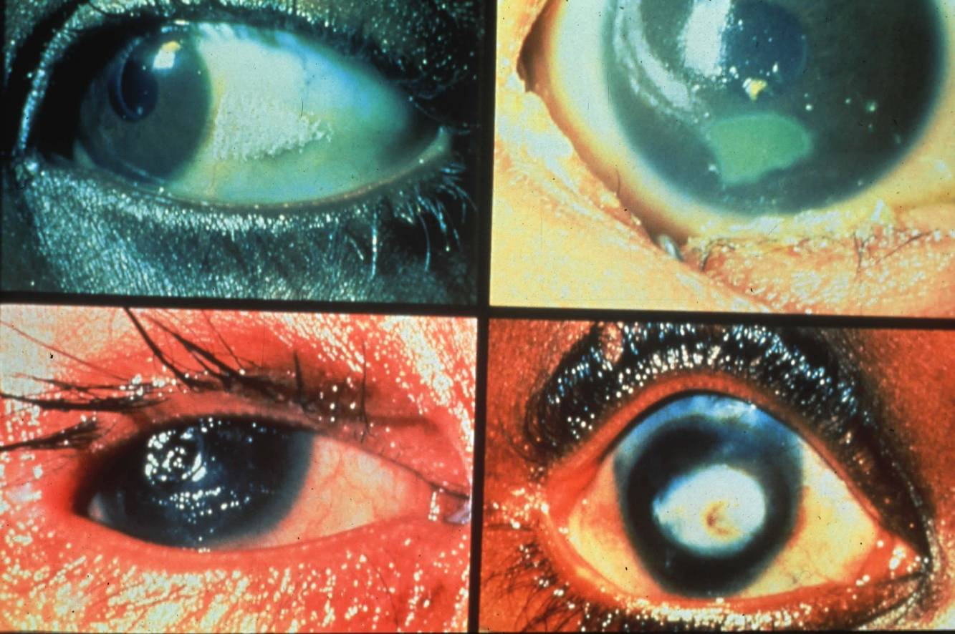
WHO Classification of Xerophthalmia
  1N Night blindness
  2B Bitot’s spots
  X3 Corneal xerosis
  X4 Corneal ulcerations -Keratomalacia
  X5 Corneal scars - permanent blindness
2B
X3
X4
X5

Slide 39
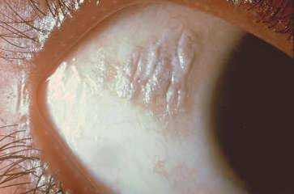
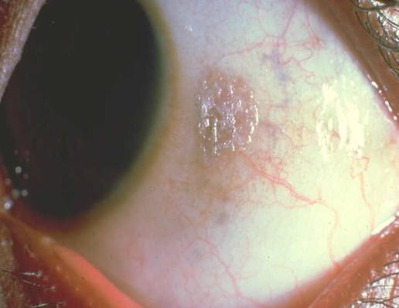
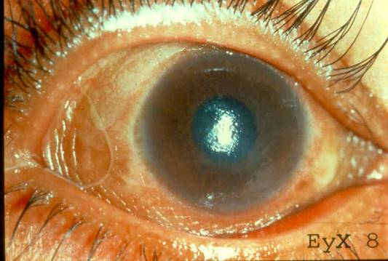
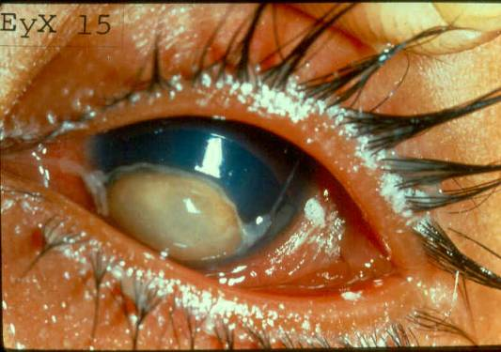
Xeropthalmia
Bitots spots (X1B) are foamy white areas on the white of the eye. Be careful not to confuse them with other types of eye problems. These signs will most often be seen in children.
Corneal Xerosis(X2)
Keratomalacia (X3)

Slide 40
VAD- Risk Factors
Low availability of vitamin A-rich foods
Lack of breastfeeding
High rates of infection (measles, diarrhoea)
Malnutrition

Slide 41
Micronutrient deficiencies in emergencies
Deficiencies of:
Vitamin C → scurvy
Niacin (vitamin B3) → pellagra
Thiamin (vitamin B1) → beriberi
…usually associated with situations where populations are fully dependent on limited commodities for their food needs.

Slide 42
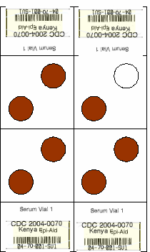
VAD - Assessment
Clinical assessment for night blindness
Biochemical assessment
  Retinol
    Serum analyzed by HPLC
    Cutoff: < 0.7 µmol/L
  Retinol-binding protein (RBP)
    Serum or DBS analyzed by ELISA
    Cutoff: ~ < 0.7 µmol/L

Slide 43
Dried Blood Spots for RBP
Quick and easy field friendly technique
Collection through venipuncture or finger stick
Fasting not necessary
DBS should completely dry and be protected from humidity
Storage of DBS at –20ºC only for short term, –70ºC for long term
Shipping of DBS cards on frozen ice packs to the laboratory

Slide 44
Poor Quality DBS
Notes:
Dry blood spot cards need to be prepared and stored properly. If they are not processed properly it will not be possible to analyze them

Slide 45
VAD- Treatment
Supplementation
  Capsules given during immunization days
Food Forms
  As pre-formed vitamin A in foods from animals
    Liver, fish
  As pro-vitamin A in some plant foods
    red palm oil, carrots, yellow maize
    Fortified blended foods (CSB or WSB)

Slide 46
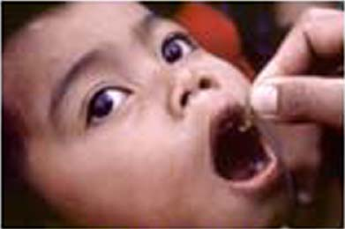
High dose oral supplements of vitamin A
Rapid and targeted
Highly effective in lowering mortality in infants and children in third world communities
Highly effective in reducing complications in measles
Reduced prevalence of malaria in children in Papua New Guinea

Slide 47
Zinc
Vitamin D
Cobalt
Iodine
Thiamin
Riboflavin
Vitamin B₆
Vitamin E
Magnesium
Manganese
Iron
Selenium
Folate
Vitamin B₁₂
Niacin
Vitamin A
Phosphorus
Vitamin K
Vitamin C
Cobalamin
Chromium
What do the micronutrients in red have in common?
Notes:
What do these micronutrients, highlighted in red, have in common?
These three MDDs are characteristic of emergency affected populations. Deficiencies of these three rarely occur in stable populations or non-emergency affected populations.
In this context, we will now discuss the specific reasons and risk factors associated with the diseases associated with deficiencies in these three micronutrients.

Slide 48
Vitamin C - Ascorbic Acid
Humans are among the few species that cannot synthesize vitamin C and must obtain it from food
Manufacture of collagen
  Helps support and protect blood vessels, bones, joints, organs and muscles
  Protective barrier against infection and disease
  Promotes healing of wounds, fractures and bruises
Sources
  Citrus fruits, strawberries, kiwifruit, blackcurrants, papaya, and vegetables

Slide 49
Scurvy – Signs & Symptoms
Small blood vessels fragile
Gums reddened and bleed easily
Teeth loose
Joint pains
Dry scaly skin
lower wound-healing, increased susceptibility to infections, and defects in bone development in children

Slide 50
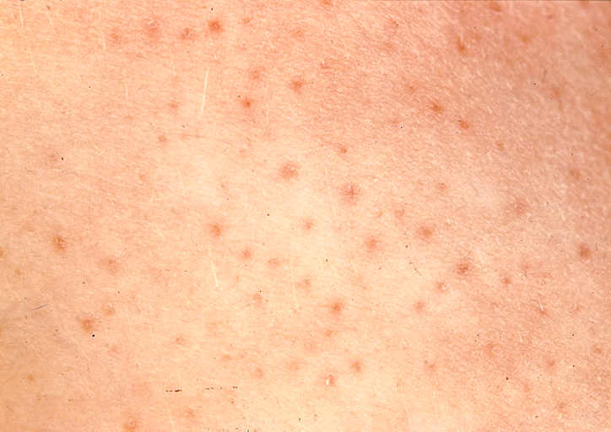
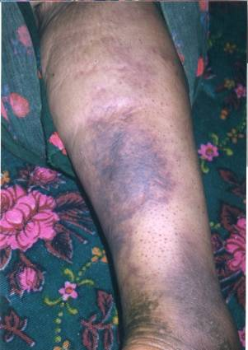
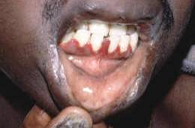
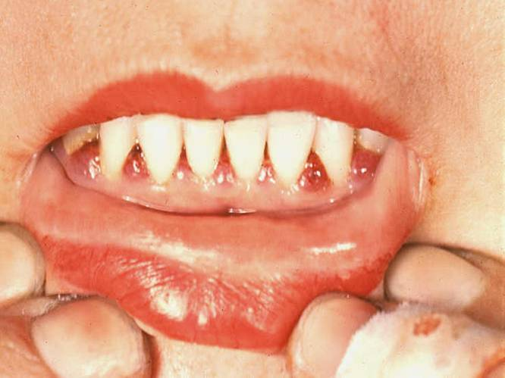
Scurvy
Bleeding around the bases of the hair on the legs (Perifollicular hemorrhage) and the gums in between the teeth are signs of scurvy. There may be areas of bruising as seen in second picture. There may also be swelling of the bone joints.
Notes:
Scurvy – Perifollicular hemorrhages
Two photos show that accurate diagnosis of MDDs are very difficult

Slide 51
Thiamin – Vitamin B1
What it does in the body
  energy production and carbohydrate and fatty acid metabolism
  vital for normal development, growth, reproduction, healthy skin and hair, blood production and immune function
Deficiency due to diets of polished rice

Slide 52
Beri Beri- Signs & Symptoms
Develop within 12 weeks
Dry Beriberi → peripheral neuropathy
  Difficulty walking and paralysis of the legs
  Reduced knee jerk and other tendon reflexes, foot and wrist drop
  Progressive, severe weakness and wasting of muscles
Wet Beriberi → cardiopathy
  Edema of legs, trunk and face
  Congestive heart failure (cause of death)

Slide 53
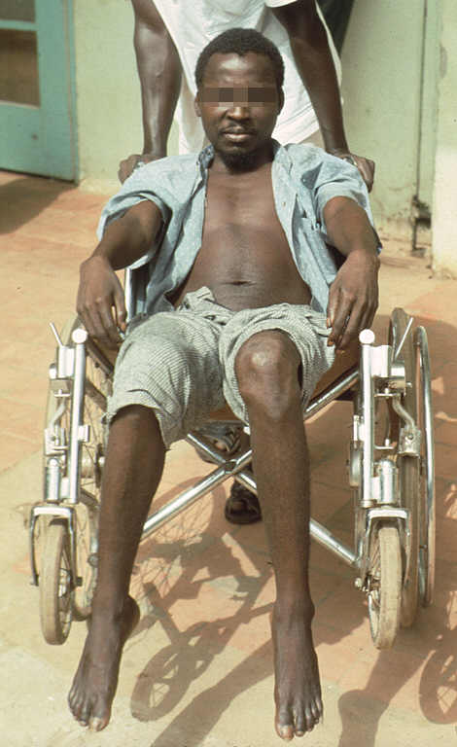
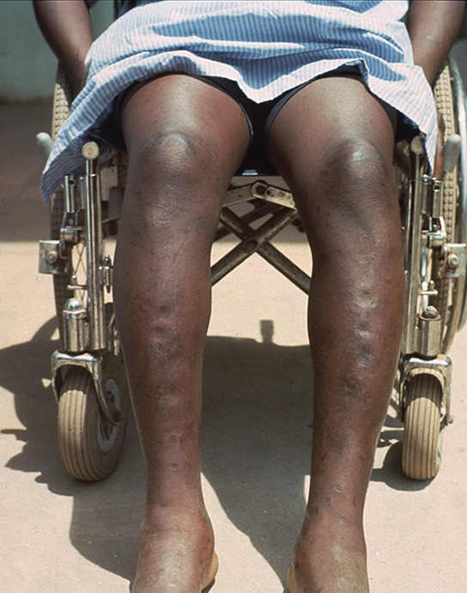
Wrist & foot drop:
Dry Beri Beri
Edema:
Wet Beri Beri

Slide 54
Riboflavin Deficiency
Deficiency is rare and often occurs with other B vitamin deficiencies
Several months for symptoms to occur
  Burning, itching of eyes
  Angular stomatitis
  Cheilosis
    Swelling and shallow ulcerations of lips
  Glossitis

Slide 55
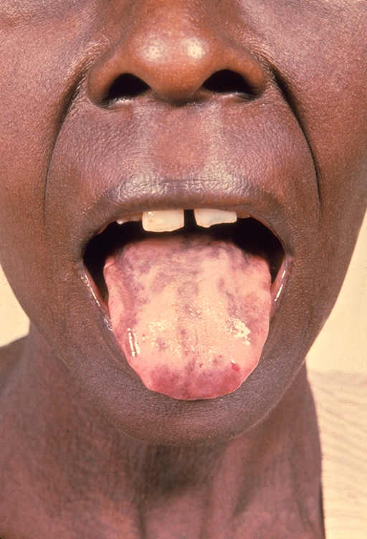
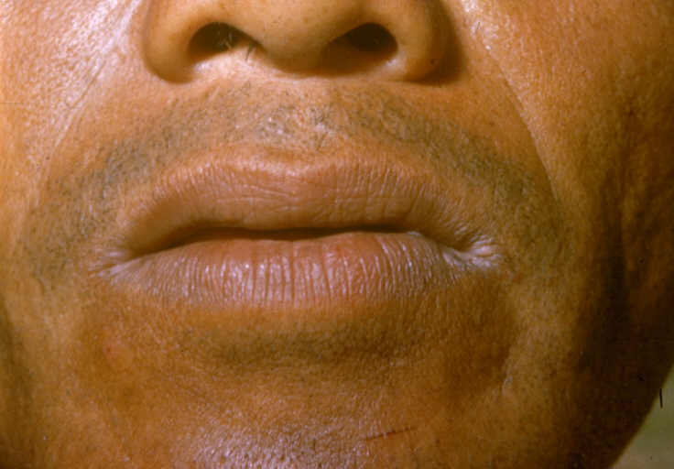
Riboflavin deficiency
Angular stomatitis
Glossitis

Slide 56
Niacin – Vitamin B3
Essential for healthy skin, tongue, digestive tract tissues, and RBC formation
Processing of grains removes most of their niacin content so flour is enriched with the vitamin

Slide 57
Pellagra – Signs & Symptoms
‘three Ds’: diarrhea, dermatitis and dementia
Reddish skin rash on the face, hands and feet which becomes rough and dark when exposed to sunlight (pellagrous dermatosis)
  acute: red, swollen with itching, cracking, burning, and exudate
  chronic: dry, rough, thickened and scaly with brown pigmentation
dementia, tremors, irritability, anxiety, confusion and depression

Slide 58
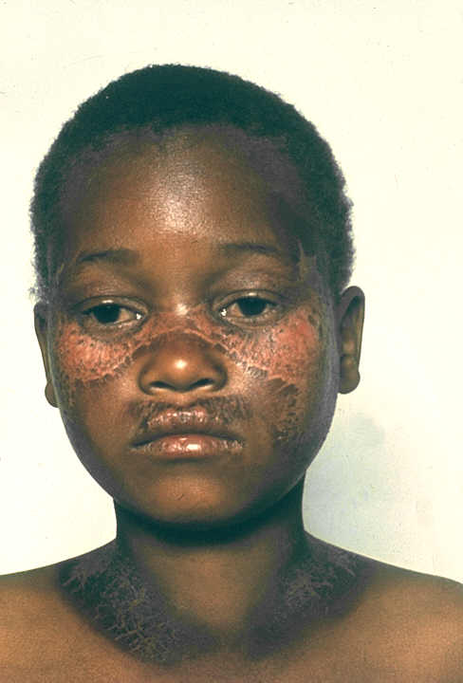
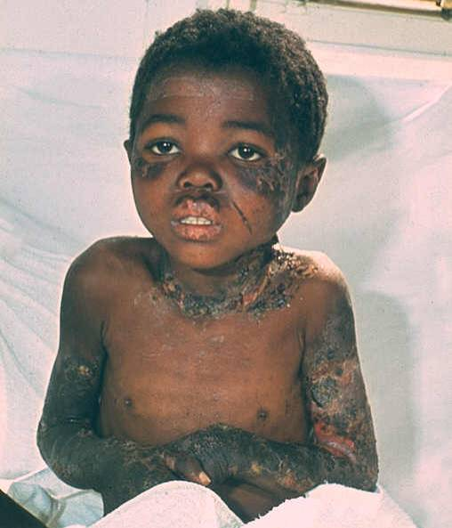
Pellagra Dermatitis

Slide 59
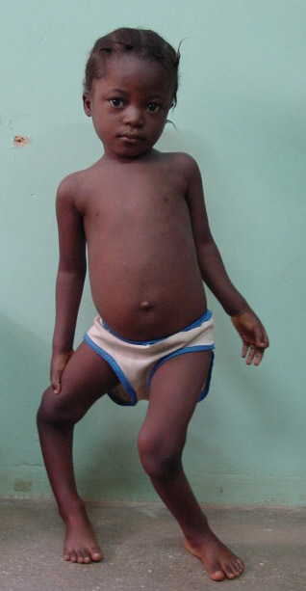
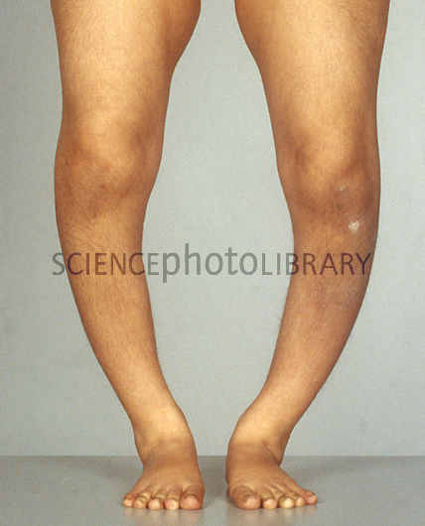
Rickets and Osteomalacia

Slide 60
Objectives
Overview of major micronutrient deficiencies
  Iron
  Iodine
  Vitamin A
  Zinc
Clinical features
Biochemical assessment
Treatment
Micronutrient deficiencies in emergencies

Slide 61
What is Malnutrition?
Malnutrition = “lack of nutrients / poor nutrition”
Two principle constituents:
  Protein-energy malnutrition
  Deficiency in micronutrients

Slide 62
Overview of Micronutrient Deficiencies
Common when dependent on relief food
Preventable, BUT
  Food sources not common and are expensive
  Fortification adds to cost of relief food
Difficult to recognize
  Symptomatic cases often represent tip of iceberg
  Laboratory assessment difficult & expensive
Lack of 1 micronutrient typically associated with deficiencies of other micronutrients
Highest risk groups
  Young children
  Pregnant Women
  Lactating women

